Slide 1
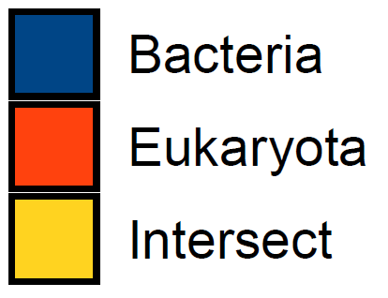

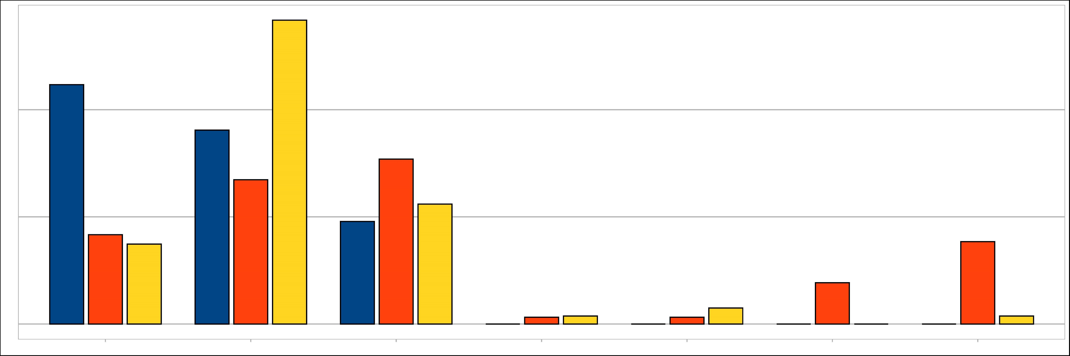
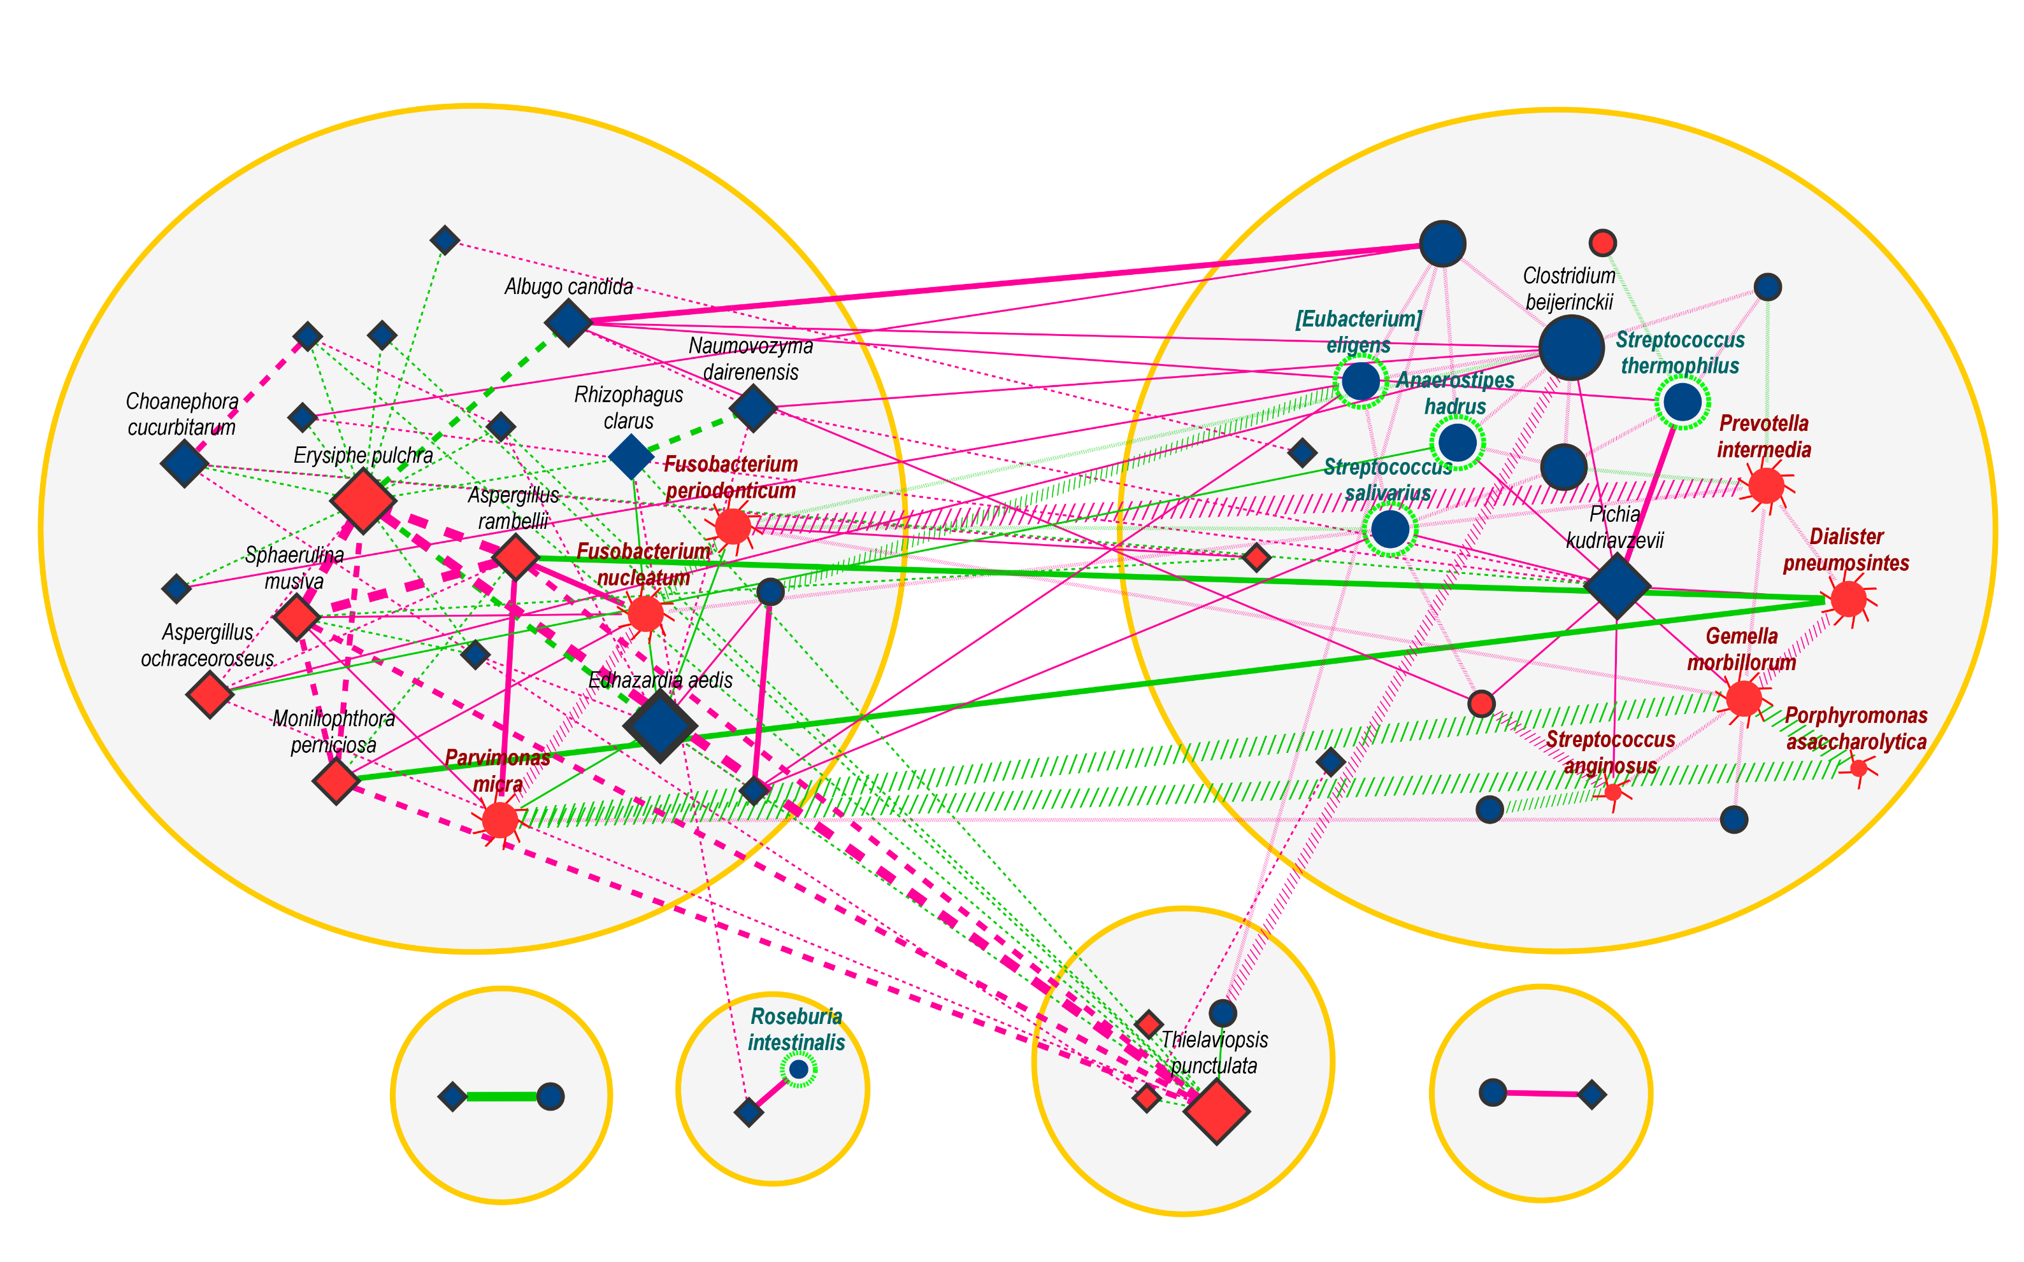



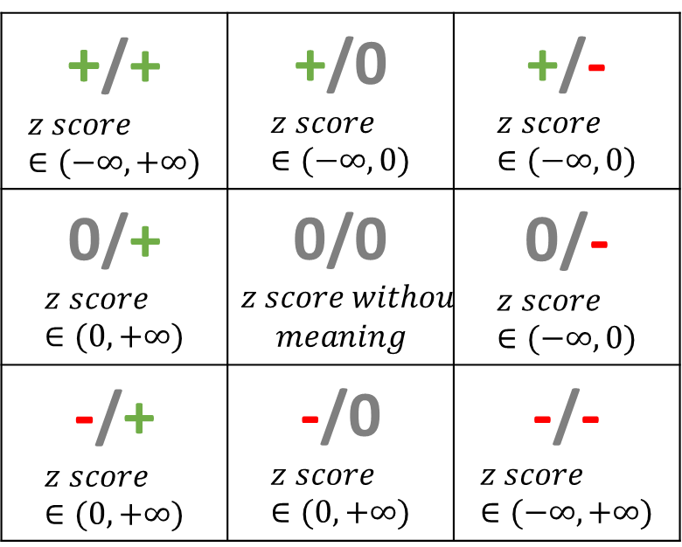
Figure 6
a
Density graph with z-score (CRC vs control)
z-score represents of the relative strength of differential correlation
0.3
0.08
Bac & Bac
0.06
Euk & Euk
0.04
Bac & Euk
0.02
0.2
0.00
-10
0
10
20
30
0.08
0.06
0.04
0.1
0.02
0.00
-10
0
10
20
30
0.15
0.10
0.0
0.05
-10
0
10
20
30
0.00
-10
0
10
20
30
b
Definition of differential correlation classes
Differential correlation classes (%)
Feature Pair Correlation in control
56.72%
Feature Pair Correlation in CRC
ρ > 0
p < 0.05
p > 0.05
ρ < 0
p < 0.05
40%
44.68%
ρ > 0
p < 0.05
+/+ $$z score ∈(−∞, +∞)$$ | +/0 $$z score ∈(−∞, 0)$$ | +/- $$z score ∈(−∞, 0)$$
0/+ $$z score ∈(0, +∞)$$ | 0/0 $$z score without$$ $$meaning$$ | 0/- $$z score ∈(−∞, 0)$$
-/+ $$z score ∈(0, +∞)$$ | -/0 $$z score ∈(0, +∞)$$ | -/- $$z score ∈(−∞, +∞)$$
36.17%
30.77%
26.92%
22.39%
p < 0.05
20%
16.67%
19.15%
14.93%
15.38%
1.49%
2.99%
7.69%
0.0%
1.28%
1.28%
0.0%
0.0%
0.0%
1.49%
ρ < 0
p < 0.05
0%
+/+
+/0
0/+
0/0
0.0%
0/-
-/+
-/0
c
Network for the differential correlation of fungi and bacteria between CRC and control
Fun_Cluster
Bac_Cluster
CRC Enriched
CRC Depleted
Reported potential
probiotic
Reported potential
pathogens
Unreported bacteria
Fungus
Counts_{corr} ≤ 5
5 < Counts_{corr} ≤ 10
10 < Counts_{corr}
z-score < 0 [Corr_{CRC} > Corr_{Ctrl} ]
z-score > 0 [Corr_{CRC} < Corr_{Ctrl} ]
External Correlation
Bacterial Correlation
Fungal Correlation
Abs(z-score) ≤ 5
5 ≤ Abs(z-score) < 6
6 ≤ Abs(z-score)

